Slide 1






INTERFACE WITH PYTHON DATABASE CONNECTIVITY:

Slide 2
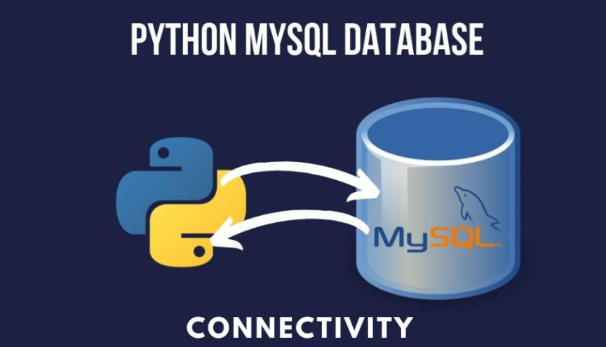
Agenda:
Introduction to Python MySql Database connectivity
DISPLAY EXISTING DATABASES IN MYSQL DATABASE
CREATE A NEW DATABASE AND SHOW DATABASES
CREATE A NEW TABLE STUDENT
ALTER TABLE STUDENT INSERT THE DATA INTO THE TABLE
UPDATE TABLE STUDENT
EXTRACT DATA FROM DATABASE

Slide 3
Python Database connectivity:
Download python IDLE 3.8.1
.
add python to the path variable.
Install My Sql 5.7.1 into the system.
Note down the user name : root and password : admin
.
Go to Script folder and type CMD

Slide 4
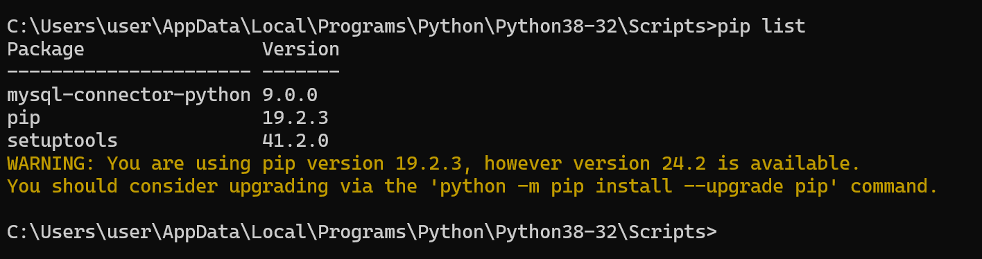
Python Database connectivity:
Install MySql-connector-python through below command:

Slide 5
Python Database connectivity :
1. Import mysql. connector module into python application
Import mysql.connector as mc
2. Establish connection between python and mysql using
con=mc.connect(host=“localhost”,user=“root”,password=“admin”,charset=“utf8”,database=“pythondb”)
3. Check the status of the connection
If con.is_connected: print(“connected successfully”) else: print(“not connected”)
4. Create cursor object
con=con.cursor()
5. Execute SQL queries
cur.execute("create database pythondb")
cur.execute("show databases")
6. Fetch the result
rows=cur.fetchall() row=cur.fetchone() rows=cur.fetchmany()

Slide 6
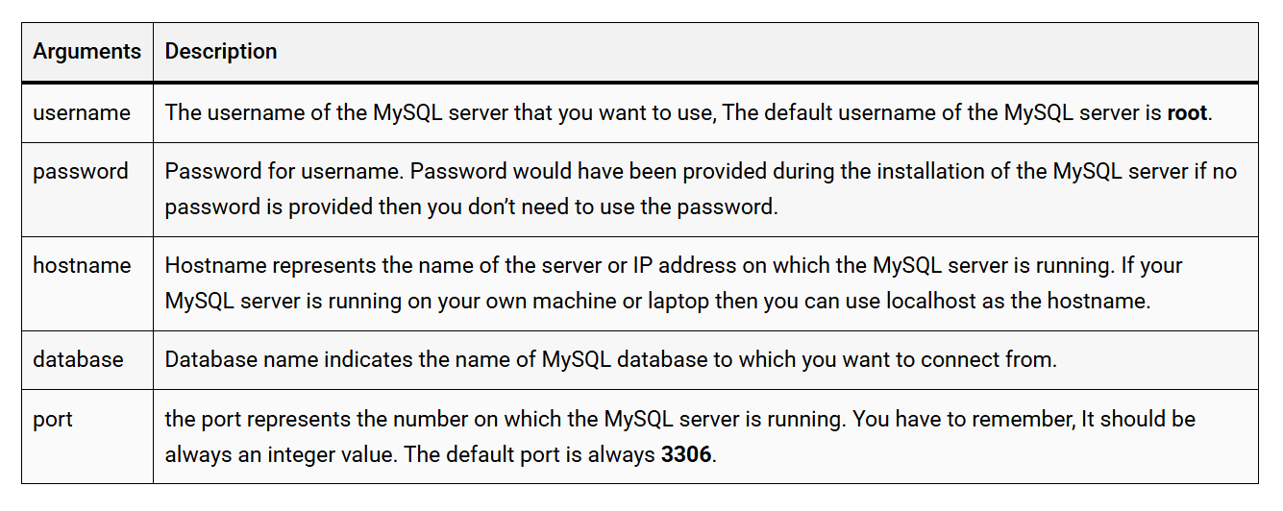
Python Database connectivity:

Slide 7
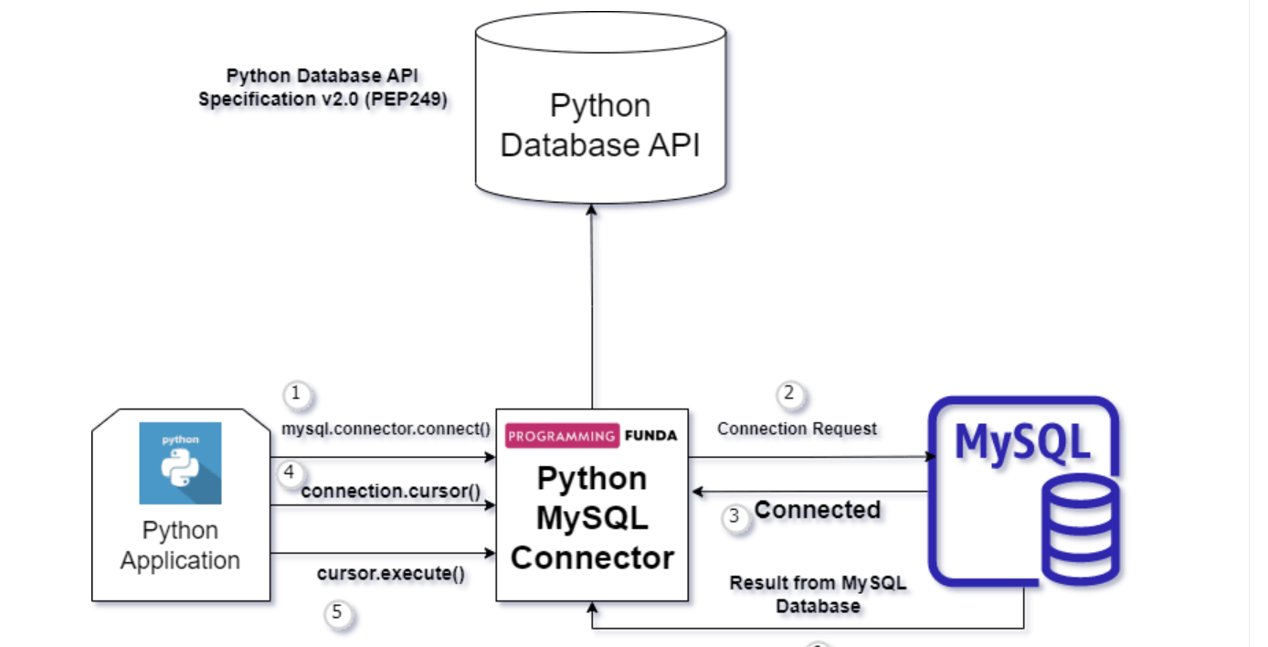
Python Database connectivity:

Slide 8
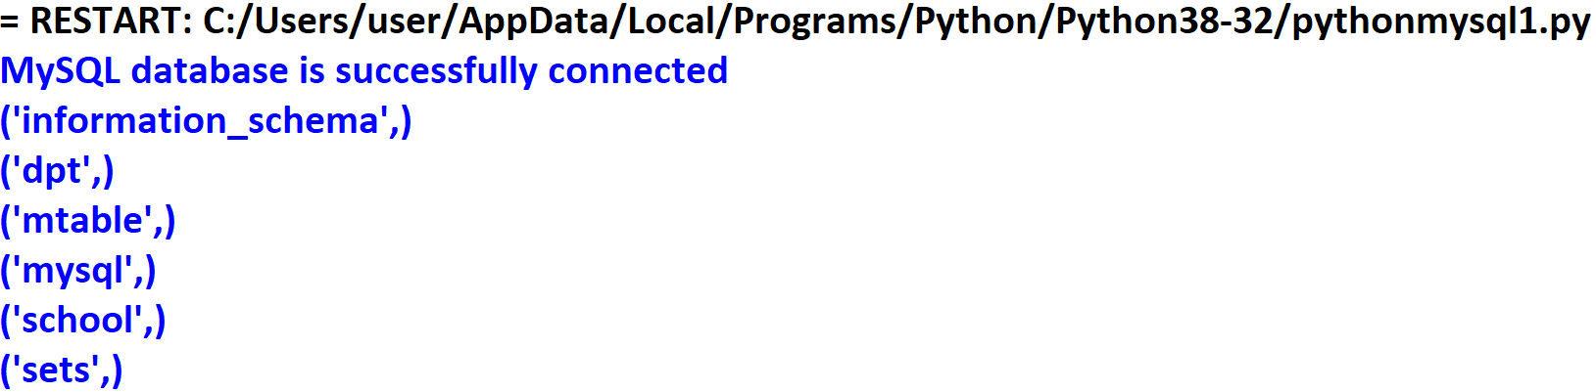
Python Database connectivity:
Display existing databases in mysql database
import mysql.connector as mc
con=mc.connect(host="localhost",user="root",password="admin",charset="utf8")
if con.is_connected():
print("MySQL database is successfully connected")
else:
print("Error in connecting to MySQL database")
cur=con.cursor()
cur.execute("show databases")
for i in cur:
print(i)
con.close()
OUTPUT

Slide 9
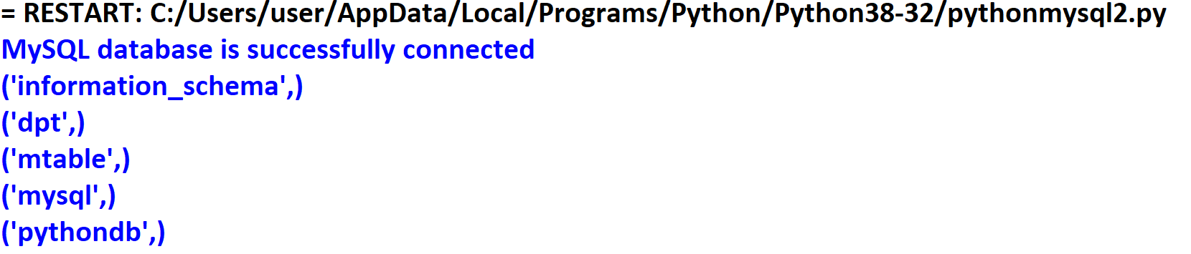
Python Database connectivity:
# create a new database and show databases
import mysql.connector as mc
con=mc.connect(host="localhost",user="root",password="admin",charset="utf8")
if con.is_connected():
print("MySQL database is successfully connected")
else:
print("Error in connecting to MySQL database")
cur=con.cursor()
cur.execute("create database pythondb")
cur.execute("show databases")
for i in cur:
print(i)
con.close()
OUTPUT

Slide 10
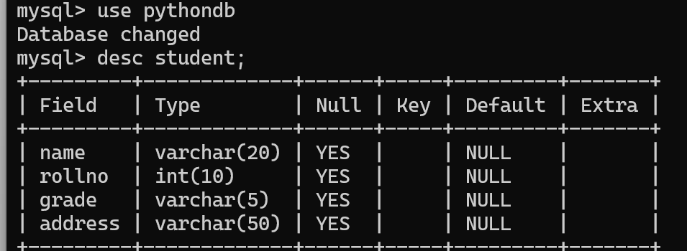
PYTHON DATABASE CONNECTIVITY:
# create a new table student
import mysql.connector as mc
con=mc.connect(host="localhost",user="root",password="admin",charset="utf8",database="pythondb")
if con.is_connected():
print("MySQL database is successfully connected")
else:
print("Error in connecting to MySQL database")
cur=con.cursor()
db=cur.execute("create table student(name varchar(20) , rollno int(10) ,grade varchar(5),address varchar(50))")
print("student table created")
con.close()
OUTPUT

Slide 11
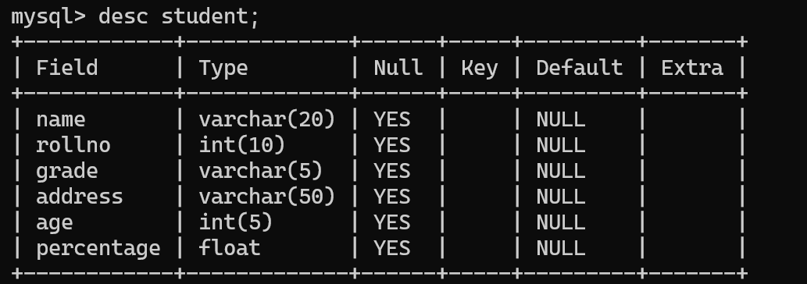
Python Database connectivity:
# Alter table student
import mysql.connector as mc
con=mc.connect(host="localhost",user="root",password="admin",charset="utf8",database="pythondb")
if con.is_connected():
print("MySQL database is successfully connected")
else:
print("Error in connecting to MySQL database")
cur=con.cursor()
db=cur.execute("alter table student add age int(5),add percentage float(5)")
print("student table altered ")
con.close()
OUTPUT

Slide 12
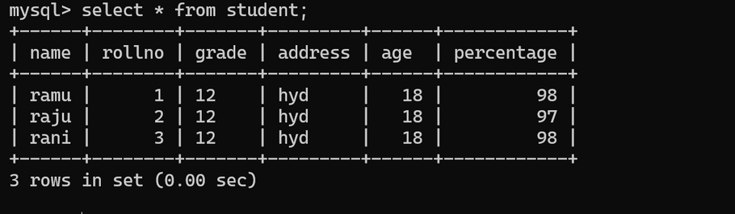
PYTHON DATABASE CONNECTIVITY:
# insert the data into the table
import mysql.connector as mc
con=mc.connect(host="localhost",user="root",password="admin",charset="utf8",database="pythondb")
if con.is_connected():
print("MySQL database is successfully connected")
else:
print("Error in connecting to MySQL database")
cur=con.cursor()
sql="insert into student(name,rollno,grade,address,age,percentage)values(%s,%s,%s,%s,%s,%s)"
data=[ ('ramu',1,12,'hyd',18,98.0), ('raju',2,12,'hyd',18,97),('rani',3,12,'hyd',18,98),]
cur.executemany(sql,data)
con.commit()
cur.close()
con.close()
OUTPUT

Slide 13


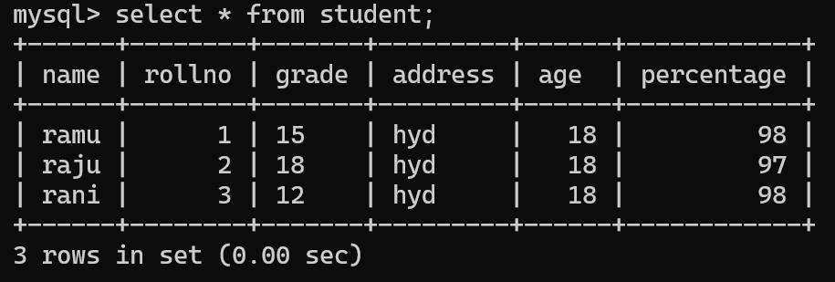
PYTHON DATABASE CONNECTIVITY:
# UPDATE TABLE STUDENT
import mysql.connector as mc
con=mc.connect(host="localhost",user="root",password="admin",charset="utf8",database="pythondb")
if con.is_connected():
print("MySQL database is successfully connected")
else:
print("Error in connecting to MySQL database")
cur=con.cursor()
sql="update student set grade=%s where rollno=%s"
data=[ (15,1),(18,2),]
cur.executemany(sql,data)
con.commit()
print("Data updated")
cur.close()
con.close()
# OUTPUT

Slide 14
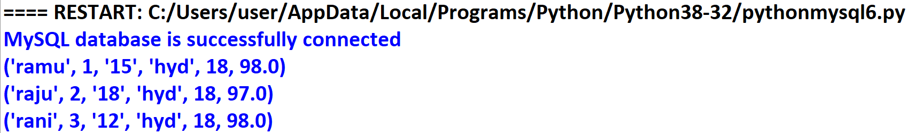
PYTHON DATABASE CONNECTIVITY:
# Extract data from database
import mysql.connector as mc
con=mc.connect(host="localhost",user="root",password="admin",charset="utf8",database="pythondb")
if con.is_connected():
print("MySQL database is successfully connected")
else:
print("Error in connecting to MySQL database")
cur=con.cursor()
'''cur.execute("select * from student")
row=cur.fetchone()
print(row)'''
cur.execute("select * from student")
rows=cur.fetchall()
for i in rows:
print(i)
con.close()
OUTPUT

